Slide 1
Restaurant API Presentation
Software Engineering (ITSC-3155-081)
Tevin Parathattal, Nicholas Smit, Jason Springer-Trammell, Walker Thierbach, Preston Murray

Slide 2
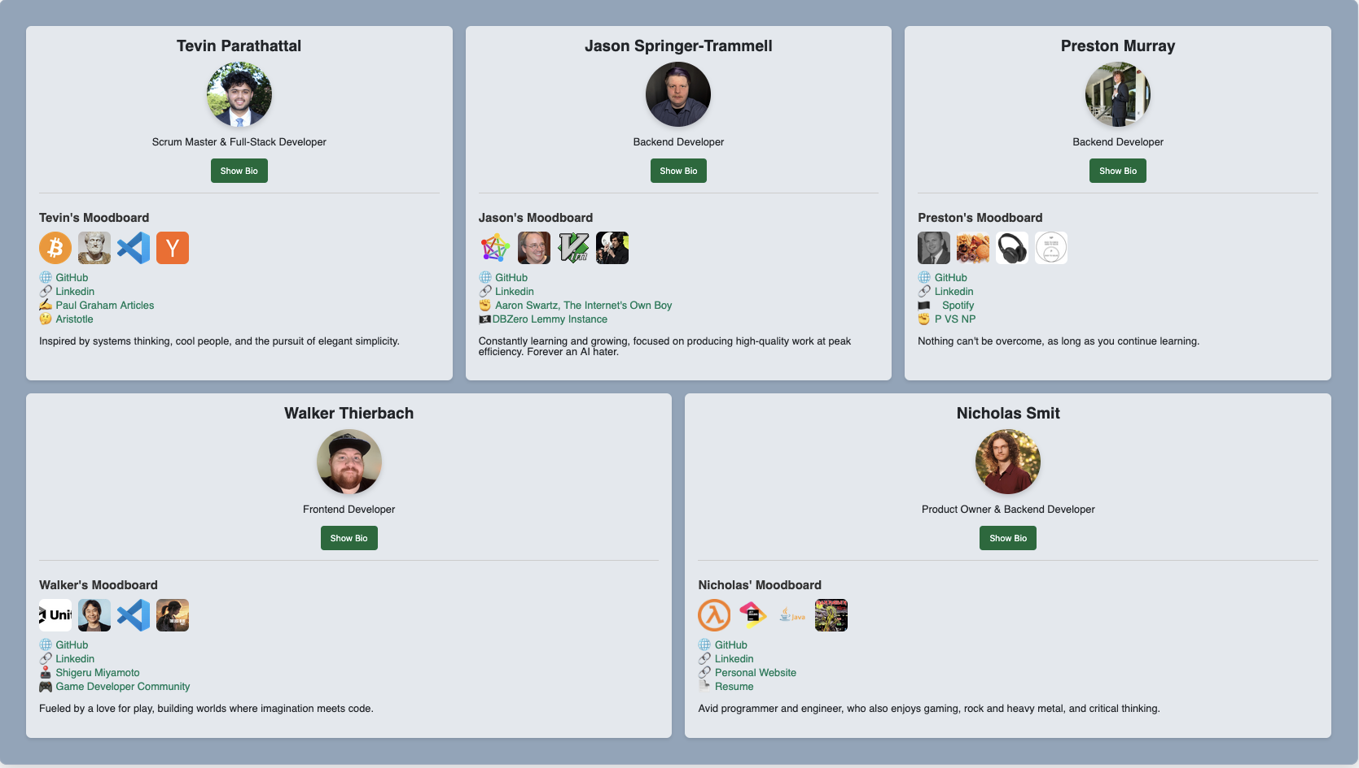
Introductions

Slide 3
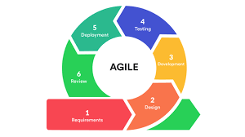
Objectives
Develop a Product Backlog
Develop Sprint Reviews and a Sprint Backlog
Ensure that we utilize the Agile Process
Ensure that we adhere to customer expectations
Create a User Manual and Technical Manual for future use

Slide 4
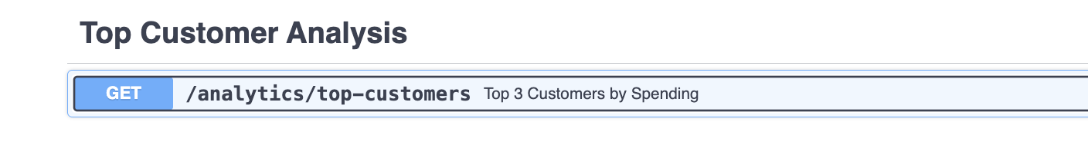
Features
Order Creation
Feedback Analysis
Popularity Insights
Creation of Menu Items
Association of Ingredients with Menu Items
And a Unique Customer Loyalty Feature

Slide 5
Demo Time
We will demo the following with prepopulated data:
Popularity Insights
Feedback Analysis
Customer Loyalty Feature

Slide 6

Key Challenges
Data Seeding and Consistency
Error Handling
Effective Analysis
Testing
Group Work in an Asynchronous Class

Slide 7

Lessons Learned
Clear Communication is Key
Error Handling is Part of the Process
Good Products Take Hard Work

Slide 8
THANK YOU!

